Slide 1

Admission System Portal
Alok Gupta : 21104028 Sankalp Gunjal : 21104087 Yatish Gharat : 21104050
Project Guide : Prof. Sonal Balpande

Slide 2
Contents
●
Introduction
●
Objectives
●
Scope
●
Features / Functionality
●
Project Outcomes
●
Technology Stack
●
Block Diagram/ Flow

Slide 3
1. Introduction
The admission portal is a digital tool that helps educational institutions manage the student enrollment process effortlessly . The main principle behind the need of college admission portal is easy supervision of institute . Portal is adaptable as it provides with features like data modification. Moreover , it provides security at product level and as well as user level
The portal has these specification :-
Student Sign Up and login.
Admin Login.
Student selection criteria.

Slide 4
2. Objectives :
The Main objective of the project is to automate the process carried out In the organisation with improved performance and using the vision of paperless work.
Some of our Objectives are listed below :-
•
Create student account and maintain the data effectively .
•
To develop a simple admission system .
•
To store the information of the student and manage them .
•
To retrieve the information when required .

Slide 5
3. Scope
Can be applied in colleges, schools and educational institutions.
Can be useful to students, parents and college faculty.
Student can apply to the courses offered by the institution knowing it’s requirements through portal.
Merit declaration and courses offered such details can be displayed through portals.

Slide 6
5. Outcome of Project
Admin & student can login.
Student can select courses offered by the college.
Admin declares the list of students placed at a particular department through the merit process .
Student record’s can be accessed in few seconds .

Slide 7
6. Technology Stack
Write what you have planned to develop front end ( GUI ) & Backend (Database if applicable)
- MySQL
- JAVA
-JDBC (connectivity)
Eclipse IDE
JAVA Swing

Slide 8
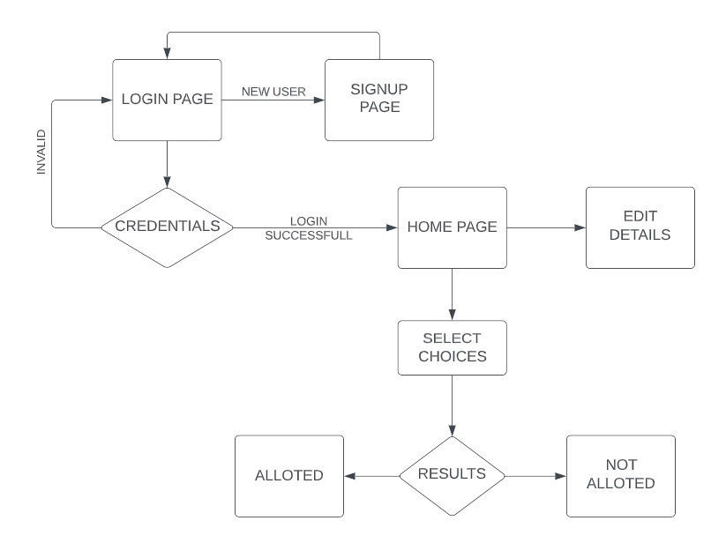
7. Block Diagram/ Flow Chart

Slide 9
Thank You...!!

